Slide 1
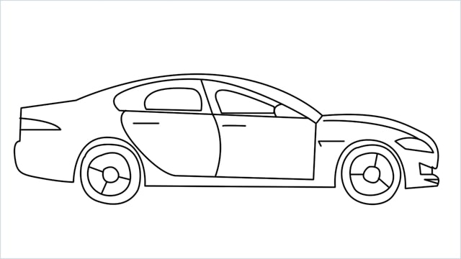

Car Price Prediction Project
Submitted By:
Ambika Saraf

Slide 2
Introduction
Covid-19 has impacted many businesses we have seen a lot of changes in car market too. One of our clients works with small traders, who sell used cars. With the change in market due to covid-19 impact, our client is facing problems with their previous car price valuation machine learning models. So, they are looking for new machine learning models from new data.
This project involves Collecting Data from various websites and then analyzing it. We have drawn conclusions about how features effect car price. Further we have build a machine learning model to predict Sale prices of used cars.

Slide 3
Steps Done:
Data Collecting Phase:
First, we collected the used cars data from different websites like olx, cars25 and it was done by using Web scraping. The framework used for web scraping was Selenium, which has an advantage of automating our process of collecting data
After that the scrapped data was combined into a single data frame and saved in csv format.

Slide 4
Steps Done(Contd.)
Model Building Phase:
First step was to clean data which included steps like finding and handling null values, removing words from numbers, converting object to int type, etc.
Data Analytics done by deeply looking into statistical description of data and visualizing distribution of each feature.
Bivariate analysis also done to determine relationship of each feature with target variable.
Data Pre-Processing involves removing outliers and dealing with the skewed data.

Slide 5
Steps Done(Contd.)
After this we separated our data using train and test split, we started running different machine learning classification algorithms to find out the best performing model
Model Evaluation was done using Cross Validation Score and checking for over or under fitting of data.
Then, we performed Hyperparameter Tuning techniques using GridSearchCV for getting the best parameters and improving the scores.
We saved the model in pkl format and then saved the predicted values in a csv format.

Slide 6

Machine Learning Model
Algorithms used are:
Linear Regression
Model Regularization using Lasso CV
Decision Tree Regressor
KNN Regressor
Random Forest Regressor
Gradient Boosting Regressor

Slide 7
Linear regression:
Accuracy = 40.12%
Mean Absolute Error= 178701.691
Mean Squared Error= 95296282075.0419
Lasso CV:
Accuracy= 40.12%
Mean Absolute Error= 178694.665
Mean Squared Error= 95292746791.80
KNN regression:
Accuracy = 57.97%
Mean Absolute Error= 121890.514
Mean Squared Error= 66881924922.21

Slide 8
Decision Tree regression:
Accuracy = 95.75%
Mean Absolute Error= 30138.88
Mean Squared Error= 6769260516.89
Random Forest regression:
Accuracy = 95.70%
Mean Absolute Error= 40700.53
Mean Squared Error= 6841275184.82
Gradient Boosting regression:
Accuracy = 92.57%
Mean Absolute Error= 64980.73
Mean Squared Error= 11829995701.9

Slide 9
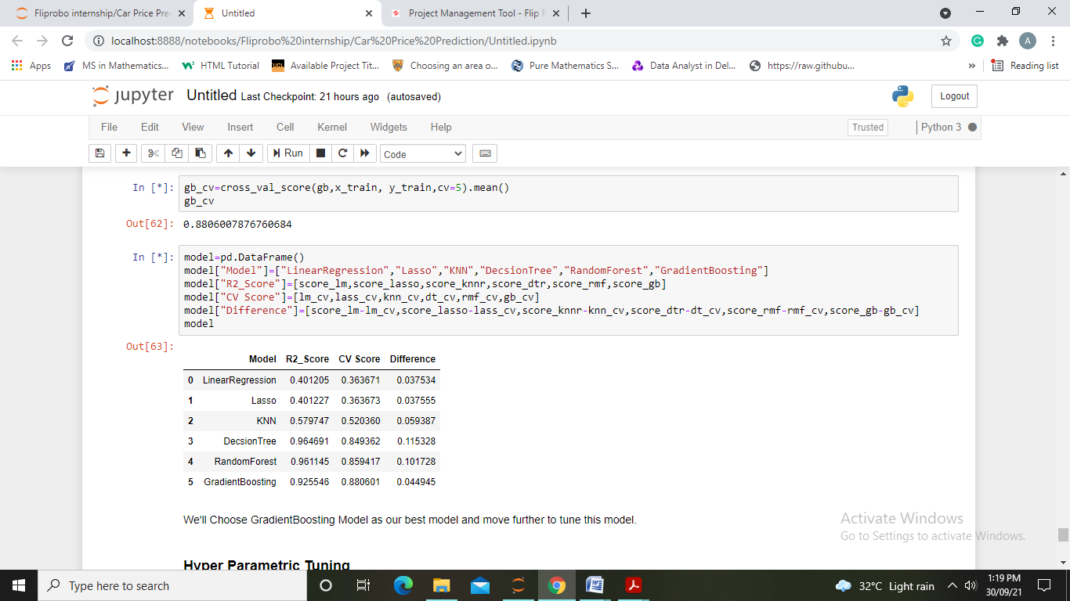
Model Evaluation
Model Evaluation using CV Score:
Thus We choose Gradient Boosting Model as our best model

Slide 10
After Hyper Parametric Tuning we get an accuracy of 91.87% with 113694.63 Root Mean Squared Error.
In Last step we have compared original prices with the predicted prices and also saved our model to for future use.

Slide 11
Conclusion
After the completion of this project, we got an insight of how to collect data, pre-processing the data, analyzing the data and building a model. It helped me to gain conclusions from graphs. Also it helped me in exploring multiple algorithms and metrics to get the best output.
First, we collected the used cars data from different websites like olx, car24 and it was done by using Web scraping. The framework used for web scraping was Selenium.
Then the scrapped data was saved in a csv file to use it for modeling purpose.
From the extensive EDA performed in this project we observed year of purchase, car name, fuel and owner directly influencing prices.

Slide 12
The model build after hyper-parametric tuning gives an accuracy for 91.87%.
Since the data keeps changing we cannot fully rely on this project in the distant future we need to update it with updation in data.
Also website was poorly designed because the scrapping took a lot of time and there were many issues in accessing to next page and thus less data was fetched.
This project is done with limited resources and can be made more efficient in future.

Slide 13
Thank You

